Slide 1

CAR RESALE PRICE PREDICTION
DATASET
GROUP 2: ABINO, ABOT, CO, DETABLAN

Slide 2
I. BUSINESS OBJECTIVES

Slide 3
Used Car Market
The often expensive prices of brand new cars - generally resulting in most consumers being unable to afford them - have resulted in a fairly lucrative second-hand car market in the Philippines. However, due to the many factors involved, attempting to determine the value of a given second-hand car is a nontrivial task, making things like sale forecasts, good purchasing and pricing decisions for such cars difficult for business owners.
Another concern in the second hand car industry is the prioritization of different characteristics of vehicles in purchases, repairs, and advertising. Due to the swathe of relevant factors involved, the relative preferences of consumers tend to be obscured under possibly irrelevant data.
The following dataset may be able to assist in accomplishing the above mentioned nontrivial tasks.

Slide 4
II. TECHNICAL APPLICATIONS

Slide 5
Used Car Prices
The work of Collard (2022) has shown that using information on second hand cars that are readily available online and Random Forest Regression, it is possible to predict the resale price of a car based on its features with an R^2 of ~0.77, which is likely to be feasible to use in business decisions.
Meanwhile, another paper by Totakura & Kosuru (2021) not only shows similarly accurate regression (R^2 of ~85-91%) using Light Gradient Boosted Machine learning but also the extraction of feature importance, allowing one to see not only which factors influence resale pricing, but also by how much.
Given the relative accessibility of such data, this seems to be a feasible method of achieveing the aforementioned business objectives.

Slide 6
III. PRIMARY WEBSITES
DESCRIPTION

Slide 7
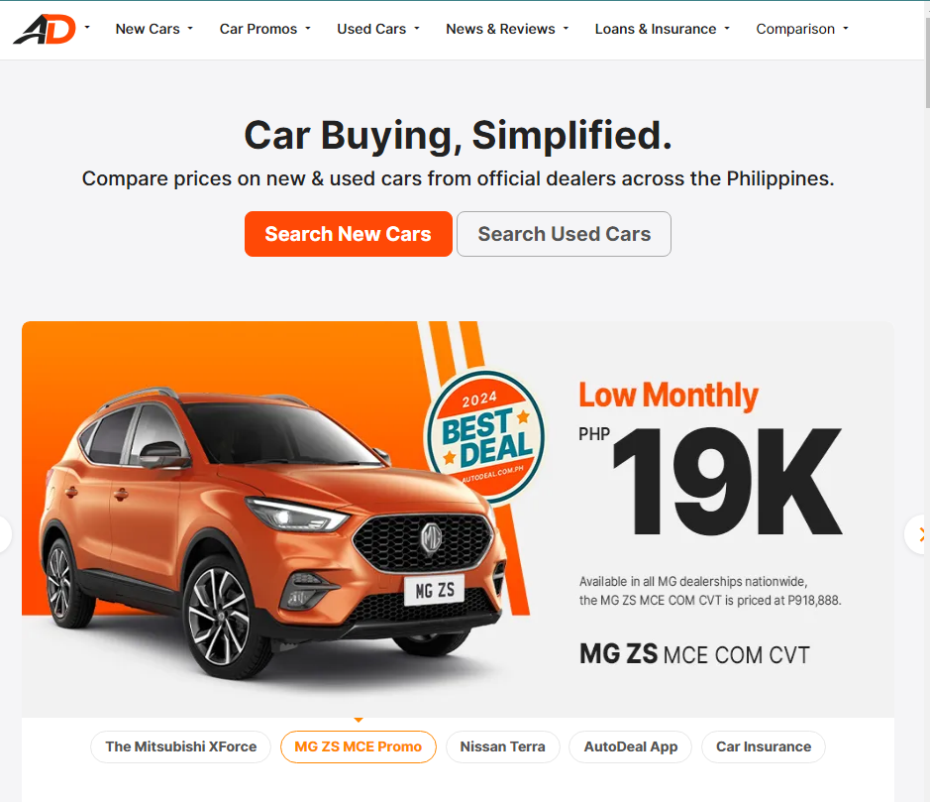
1. AUTODEAL WEBSITE: USED CARS
Using the website of AutoDeal (https://www.autodeal.com.ph/), the home screen has filters at the top bar as seen on the screenshot. Since our primary dataset contains used cars, we used the “Used Cars” filter, proceeded with “Used Cars for sale”, and searched for cars available.

Slide 8
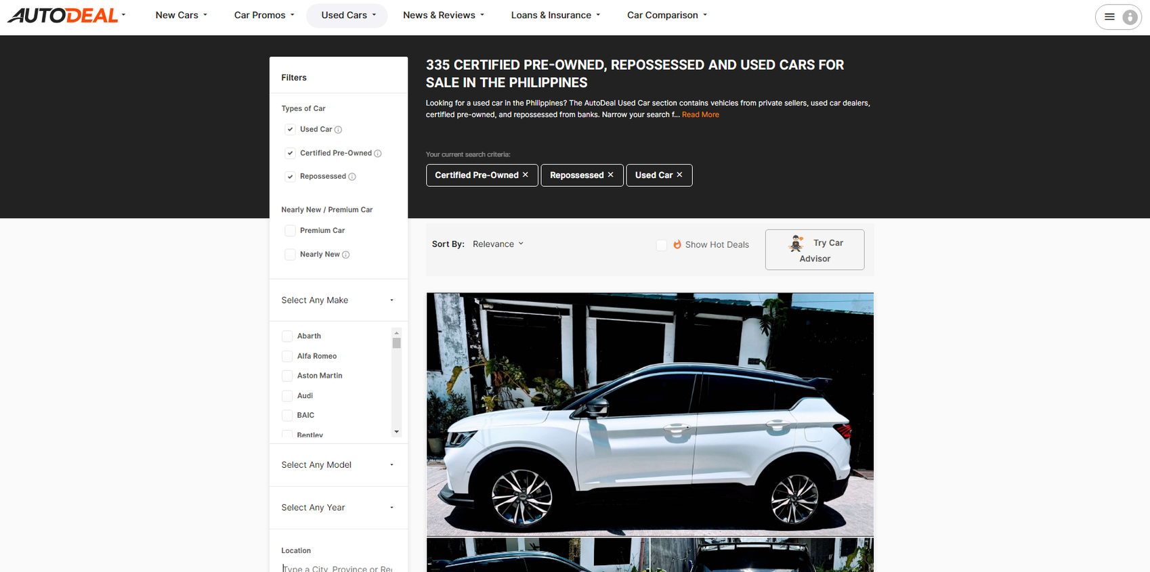
1. AUTODEAL WEBSITE: USED CARS
After clicking those filters, it should display the used cars listed for sale (see the image).

Slide 9
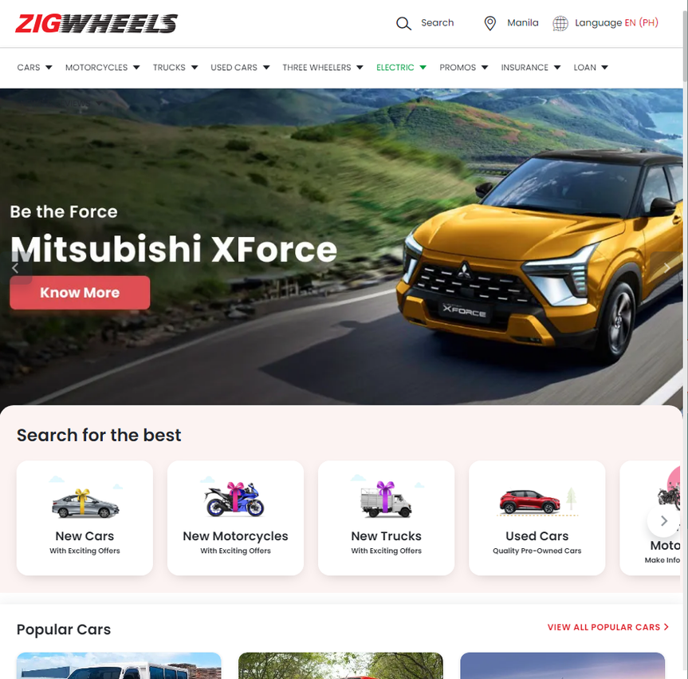
2. ZIGWHEELS WEBSITE: USED CARS
For the second primary website to web scrape from (https://www.zigwheels.ph/), the functionalities of the website is similar to AutoDeal. Using the top bar filter, clicking “Used Cars” drop down button, and clicking “Buy Used Cars” redirects the user to the used cars listing available to buy in the website.

Slide 10
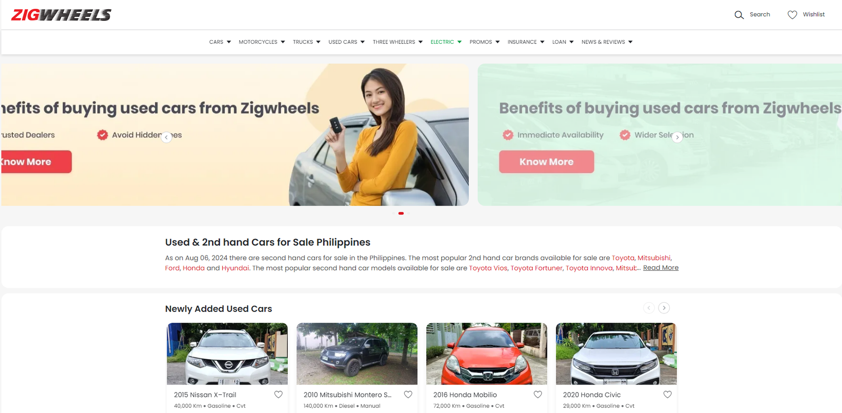
2. ZIGWHEELS WEBSITE: USED CARS
After clicking those filters, it should display the image shown below.

Slide 11
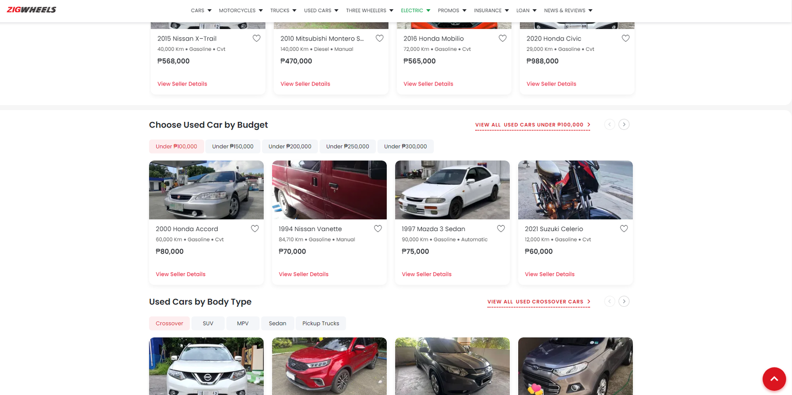
2. ZIGWHEELS WEBSITE: USED CARS
Scroll down and click “View All Used Cars Under P100,000”.

Slide 12
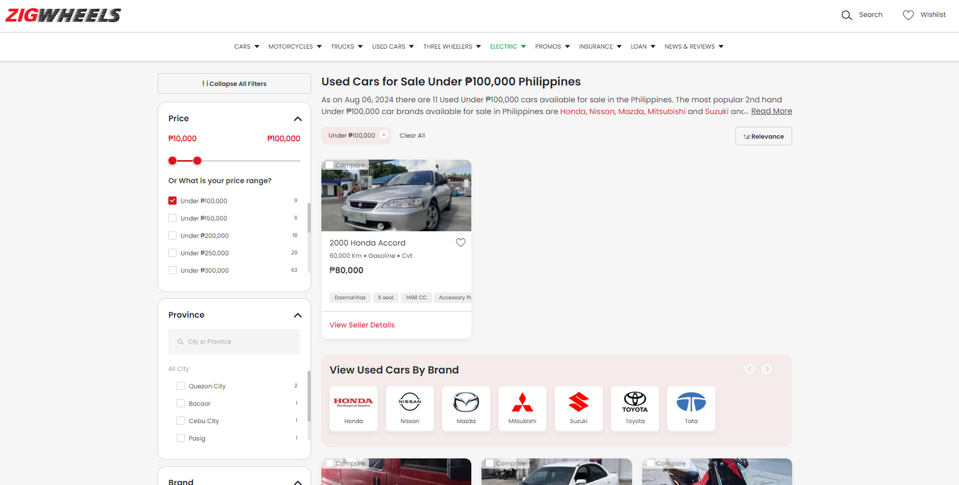
2. ZIGWHEELS WEBSITE: USED CARS
It will redirect the user to a webpage that contains useful filters on the left tab that can help control the price range, city where it is sold, brand, etc.

Slide 13
IV. EXTERNAL WEBSITES
DESCRIPTION

Slide 14
1. AUTODEAL WEBSITE: NEW CARS
Using the same website of AutoDeal (https://www.autodeal.com.ph/). However in this case, instead of using “Used Cars” filter, “New Cars” button is used to extract the brand new cars.

Slide 15
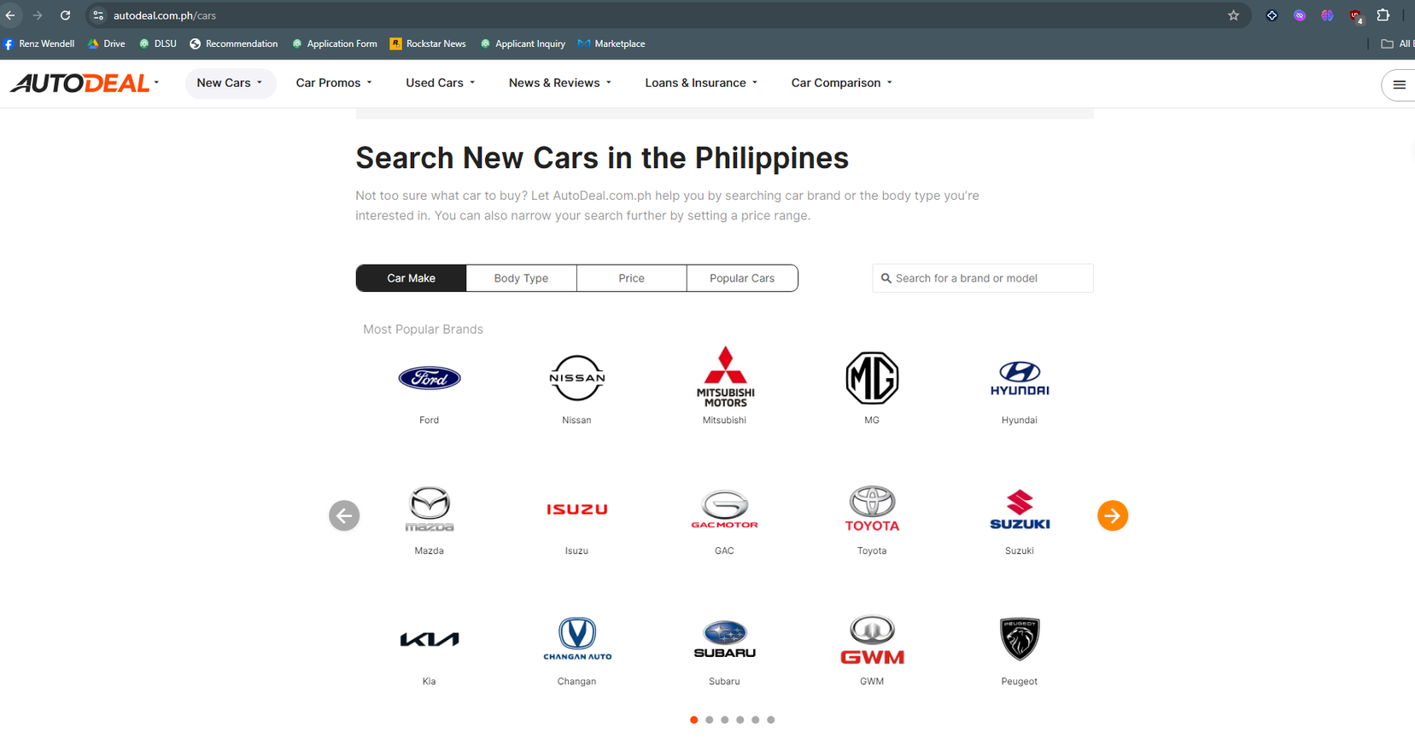
1. AUTODEAL WEBSITE: NEW CARS
From there, it displays car brands from which a user can choose from.

Slide 16
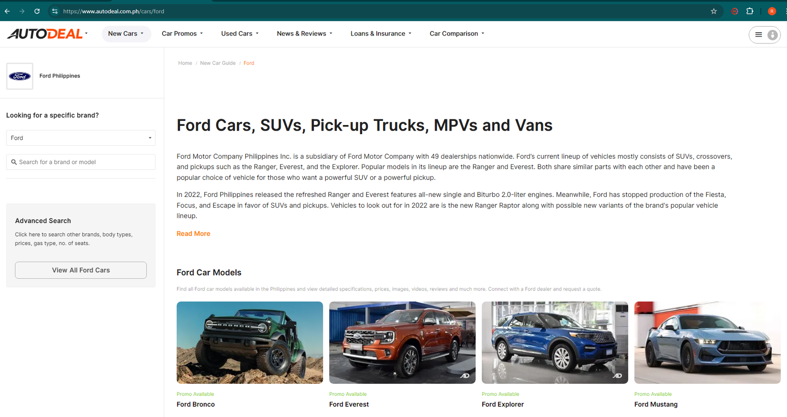
1. AUTODEAL WEBSITE: NEW CARS
As an example, this displays after clicking Ford.

Slide 17

2. ZIGWHEELS WEBSITE: CAR SERVICE CENTERS
Using the same website Zigwheels (https://www.zigwheels.ph/). After visiting the website, click “CARS” drop-down button, and select “Car Service Center”.

Slide 18

2. ZIGWHEELS WEBSITE: CAR SERVICE CENTERS
It should redirect the user to this web page where a user can select any car brands and city to view the available car service centers.

Slide 19
V. DATA PREPARATION PROCESS DOCUMENTATION

Slide 20
DATA COLLECTION
A. PRIMARY DATASETS
AutoDeal Used Cars
Zigwheels Used Cars
PRIMARY DATASET
CONCATENATE
B. EXTERNAL DATASETS
AutoDeal Brand New Cars
Zigwheels Car Service Centers

Slide 21
A. PRIMARY DATASETS
AutoDeal Used Cars
Zigwheels Used Cars

Slide 22
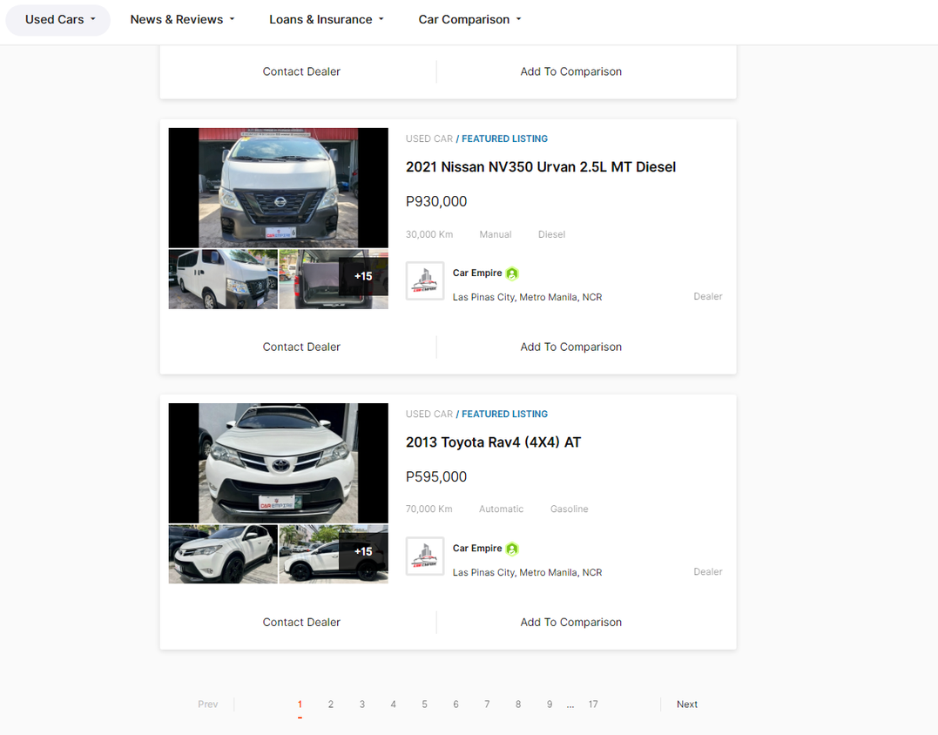
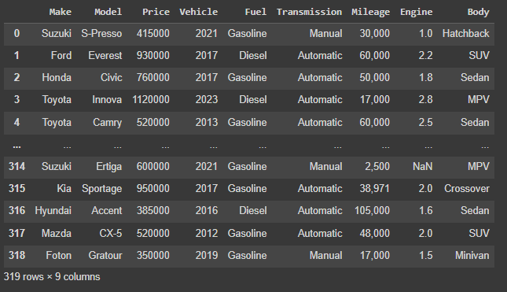
AutoDeal Used Cars
AutoDeal Website
Web scraped dataset
See autoDealWebScraping.ipynb
for the codes.

Slide 23
AutoDeal Used Cars
Upon observing and seeing patterns from AutoDeal, we noticed that after clicking the filter “Used Cars”, the website has a page number in the url that iterates upon clicking onto the succeeding pages (see the bold text below).
https://www.autodeal.com.ph/used-cars/search/certified-pre-owned+repossessed+used-car-status/page-1?sort-by=relevance
With that, the for loop was utilized to ensure that after collecting all the cars and its data from each page, it moves on to the next. After getting all the cards from the cars in each page, we took the necessary car features and proceeded to contain them in a Pandas data frame, and saved as csv.

Slide 24
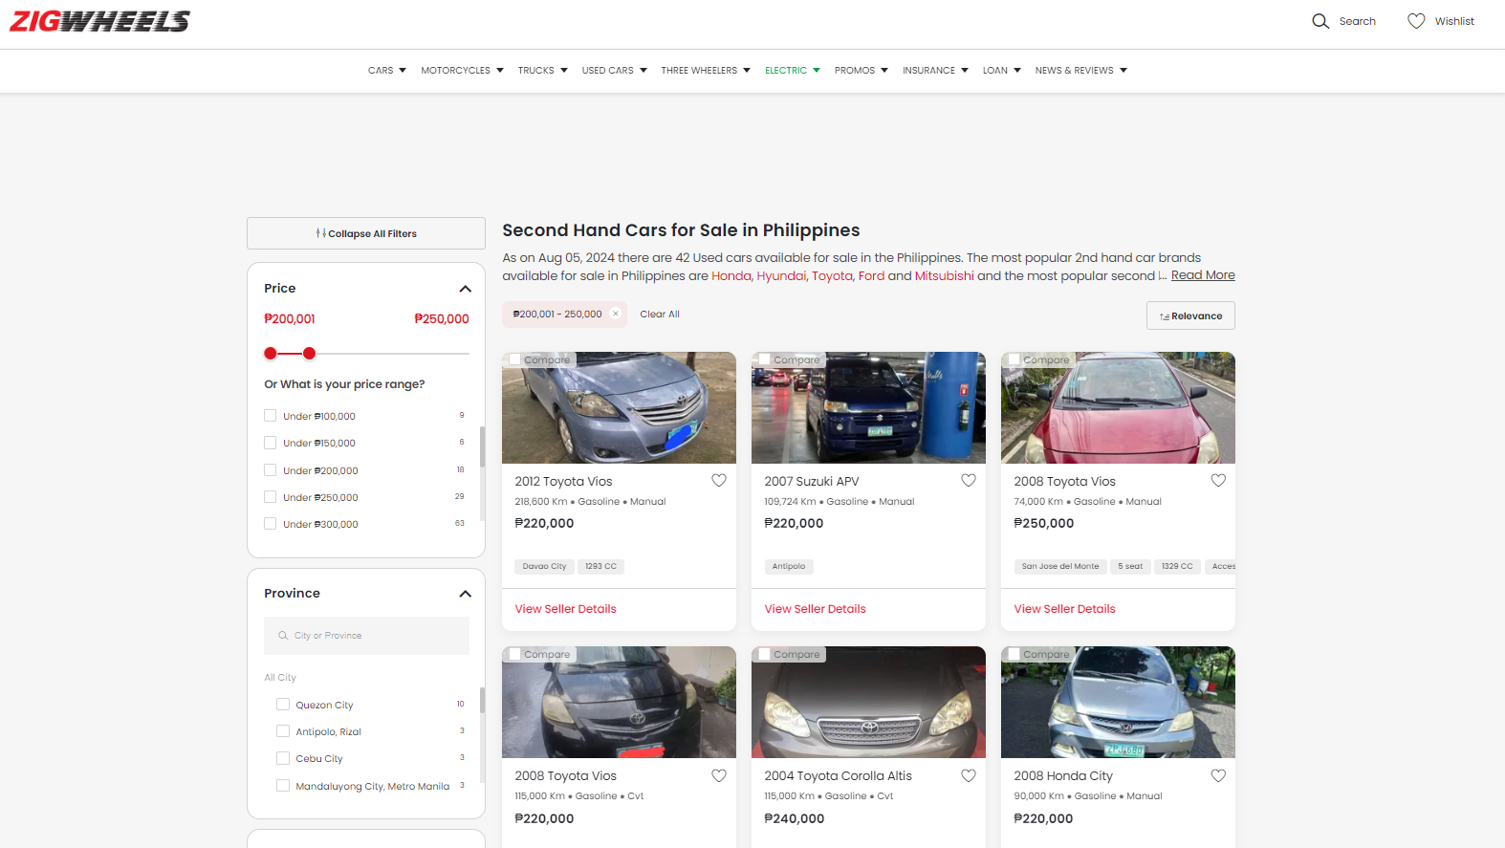
Zigwheels Used Cars
Zigwheels Website

Slide 25
Zigwheels Used Cars
Problems
The data from the website are categorized by a certain price range, i.e. Under PHP100,000, above PHP40,000,000 etc. We had trouble in scraping the data from this Website due to several reasons:
In each webpage, there are initially 21 <li> class of car cards in which we can scrape the data from and we have to click the “View More” button in order for the other car cards to pop-up. However, with a certain price range, say PHP 1 Million - PHP 1.1 Million, there are 116 cars under that price range. Because of the “View More” button, it restricts us to from getting the 95 car data.
Frequency of cars that have the same number of resale price also affects our data extraction. If there are more than 21 cars that has the same resale price, we are forced to extract the first 21 cars only in the page.

Slide 26
Zigwheels Used Cars
Solutions
“View More” Button
We overcame this problem by implementing Selenium in the code. We learned it through this YouTube tutorial:
https://www.youtube.com/watch?v=Dt66BsSlIgM
For the Action class and other debugging in the code was solved by simply searching on the internet - specifically the ones posted in stackoverflow.com/. However, when we implemented this method, it seemed that the View More button isn’t a button class and always produced an error in which it says that another button or class is receiving the clicks instead of the View More. We didn’t get to solve this issue but upon further research, we assume that it has something to do with hidden elements or wrapper classes.

Slide 27
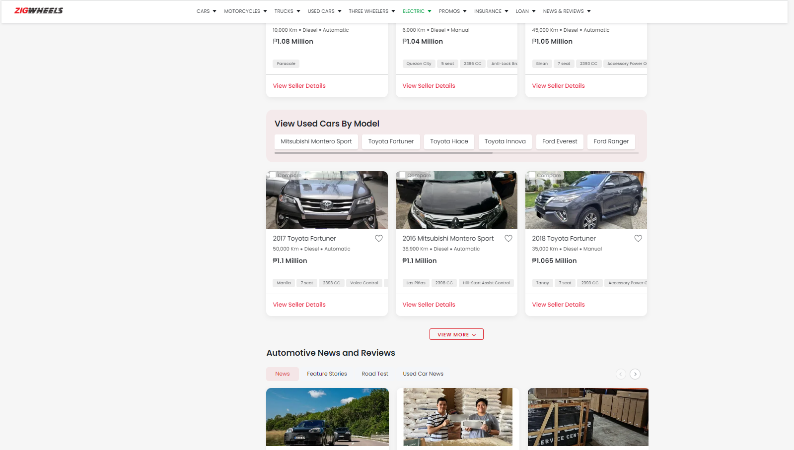

Zigwheels Used Cars
View More Button

Slide 28
Zigwheels Used Cars
Solutions
Alternative Solution for “View More” Button
We realized that, we can manually adjust the resale price range in zigwheels by applying this format in the URL:
https://www.zigwheels.ph/used-cars?p=1000001-1100000
Where, 1000001 is the lower bound and 1100000 is the upper bound of the price range. After this, we will sort the car prices from low to high using Selenium and Action class for clicking the Relevance -> Price Low to High buttons. From there, we extract 21 car data at a time and get the price of the last car extracted to set as the new lower bound for the webpage URL. In this way, we were able to maximize the number of data we could extract while minimizing the duplicates during the webscraping process.

Slide 29
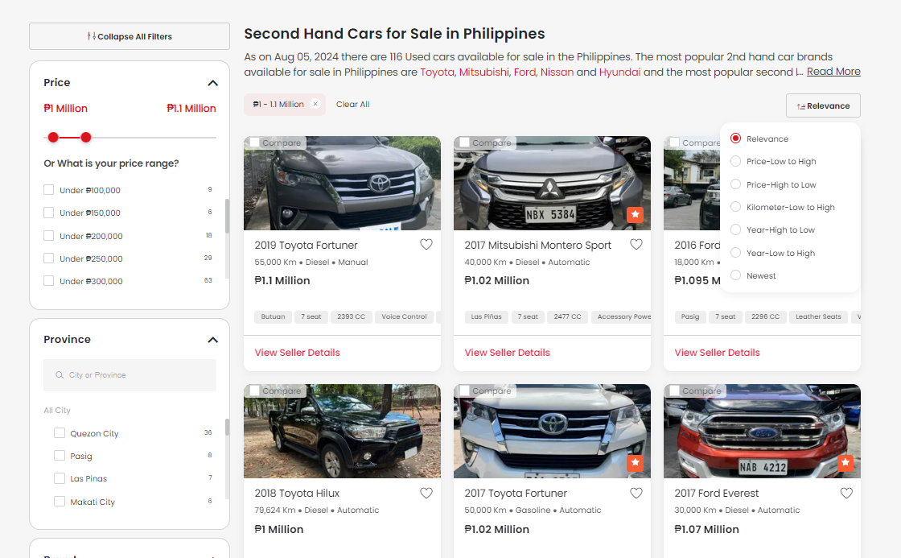
Zigwheels Used Cars
Sorting Method
1
2

Slide 30
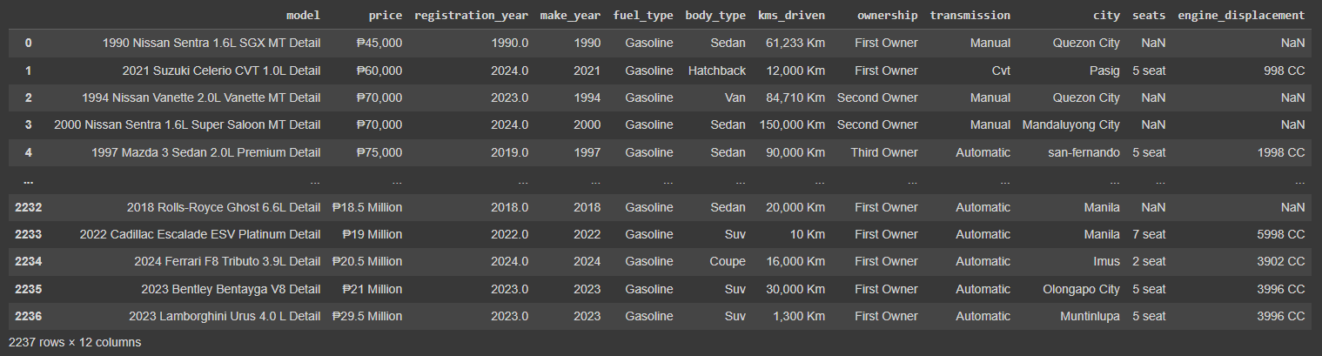
Zigwheels Used Cars
Web Scraped Dataset
See zigwheelsWebScraping.ipynb
for the codes.

Slide 31
A. PRIMARY DATASETS
AutoDeal Used Cars
Zigwheels Used Cars
PRIMARY DATASET
CONCATENATE

Slide 32
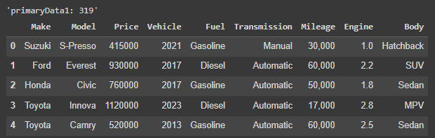
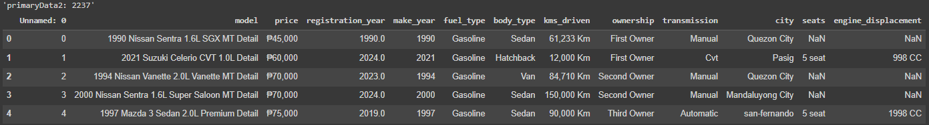
PRIMARY DATASET
CONCATENATION
AutoDeal Used Cars
Zigwheels Used Cars

Slide 33
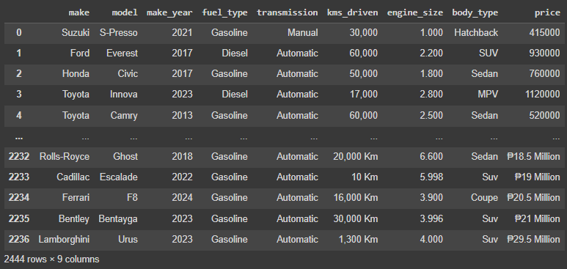
PRIMARY DATASET
CONCATENATION
A little bit cleaning, rearrangement, and renaming was done for Zigwheels dataset to match the column names of AutoDeal dataset to concatenate the two (See Concatenation and Rearrangement.ipynb for full detail of the procedure).
Afterwards, we now have the concatenated dataset (see the screenshot).

Slide 34
PRIMARY DATASET
The following columns that make up the primary dataset were chosen to be mostly consistent with the datasets used in the aforementioned sources, with a few a minor additions, and insignificant removals:
Independent Variables
make_year - Year the car was manufactured
make - manufacturer of the vehicle
model - model of the vehicle
transmission - type of transmission (eg. manual, automatic, etc.)
body_type - eg. sedan, hatchback, pick-up, SUV, etc.
fuel_type - eg. gasoline, diesel, electric, etc.
kms_driven - distance travelled since first purchase in kilometers
engine_size - volume of engine in liters
Dependent Variable
resale_price - selling price on website as second-hand car in PHP (TARGET)

Slide 35
B. EXTERNAL DATASETS
AutoDeal Brand New Cars
Zigwheels Car Service Centers

Slide 36
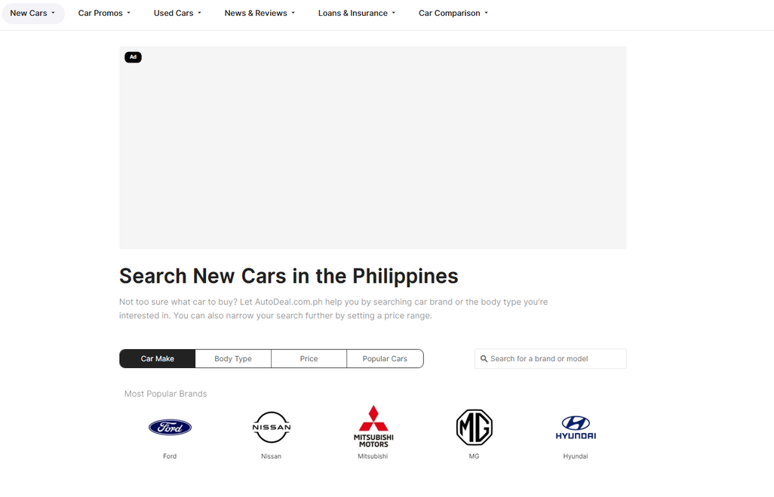
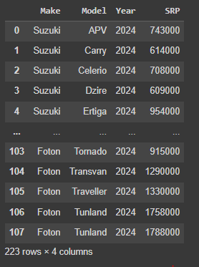
AutoDeal Brand New Cars
AutoDeal Website
Webscraped Dataset
See autoDealExternal.ipynb for the codes.

Slide 37
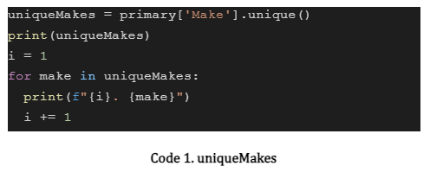
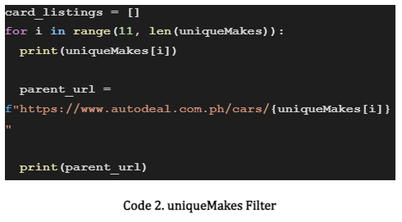
AutoDeal Brand New Cars
We decided to make use of the price of brand new cars from AutoDeal to merge it with the primary dataset so that we have an additional column called SRP (price of a brand new car) that could provide a valuable use in comparison to the resale price from the used cars dataset. To make the data collection faster, we looked for the unique Makes and stored it in a list, then iterated through it to only web scrape the Makes that are in the primary dataset.

Slide 38
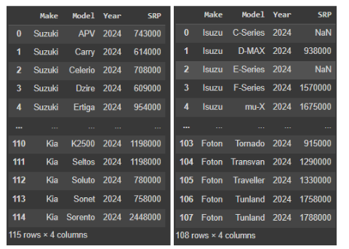
AutoDeal Brand New Cars
There was a problem during web scraping that stopped the code because one car had no listed price that caused an error. A simple solution we made is that we web scraped first from Suzuki to Kia, then Isuzu to Foton to avoid the error.

Slide 39
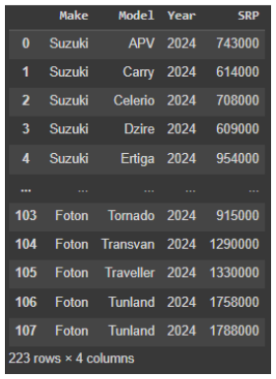
AutoDeal Brand New Cars
Then, we concatenated the two to finally get the first external dataset and saved as a csv file, autoDealExternal.csv in folder 2.

Slide 40
AutoDeal Brand New Cars
External Dataset 1
Under the assumption that the current SRP of a car of the same make and model of an older, to-be-resold car has some bearing on the latter’s value/pricing, the resulting first external dataset consists of the following columns:
Make - manufacturer
Model - (self explanatory)
Year - year of manufacture (all 2024, the current year when the resale prices were set), later renamed to ext_make_year
SRP - corresponding initial price as indexed by the above three columns
The scope of said first two columns was derived from the corresponding scope in the primary dataset, and these two columns were concatenated into a third “key” column on which this external dataset was merged with the primary, on a similar “key” column.

Slide 41

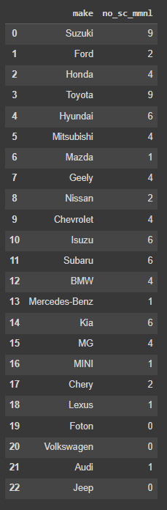
Zigwheels Car Service Centers
Zigwheels Website
Dataset
There is no notebook for this because the
data collection for this dataset is done
manually. This was saved as a csv file, make_mshops.csv in the datasets folder.

Slide 42
Zigwheels Car Service Centers
External Dataset 2
Though no source had yet used such data for prediction, it seems plausible that the number of service centers in Metro Manila for each manufacturer is a relevant factor to pricing, since the access to maintenance facilities is a likely concern for consumers, especially for second-hand cars. Thus, the second external dataset consists of two columns:
make - manufacturer
no_sc_mmnl - the corresponding number of service centers in Metro Manila of the manufacturer in the column above
This external dataset was merged with the primary on the former (Make) column.

Slide 43
2. DATA PROCESSING
PART 1. DATA CLEANING
PART 2. DATA TRANSFORMATION
PART 3. MERGE
PART 4. CATEGORICAL PROFILING AND ENCODING VARIABLES

Slide 44
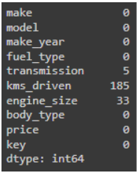
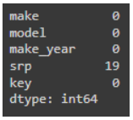
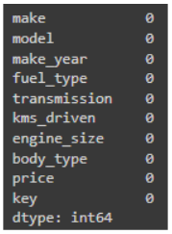
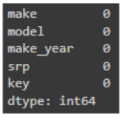
PART 1. DATA CLEANING
We imported primaryData.csv, and proceeded to check the number of nulls per column in the primary dataset first.
We imported externalData.csv, and proceeded to check the number of nulls per column in the external dataset.
We then proceed to drop nulls in the columns kms_driven, transmission, and engine_size because no other data cleaning techniques taught in class besides dropping rows are reasonable to do. Now, that leaves us having zero nulls for the primary dataset.
Dropping all the rows of srp was necessary since those nulls are the cars in AutoDeal that do not have a current price listing from the website. Now, we have no nulls anymore for the externalDataset.

Slide 45
PART 1. DATA CLEANING
Then we saved these two cleaned datasets and exported them as: cleanedPrimaryData.csv, and cleanedExternalData.csv.

Slide 46
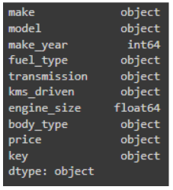
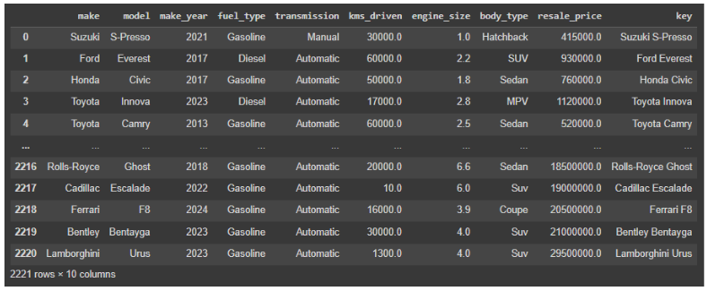
PART 2. DATA TRANSFORMATION
We imported cleanedPrimaryData.csv, and proceeded with the data transformation of the primary dataset (see the summary of the data types of the primary data.
We then converted the column name price into resale_price then transformed it from an object to float, then kms_driven (truncated “km”), and engine_size (rounded it by two decimals) (kindly see Part 2. Data Transformation.ipynb for the full details).

Slide 47
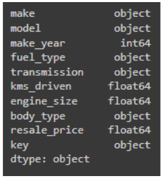
PART 2. DATA TRANSFORMATION
After the procedure, we now have these newly converted data types.

Slide 48
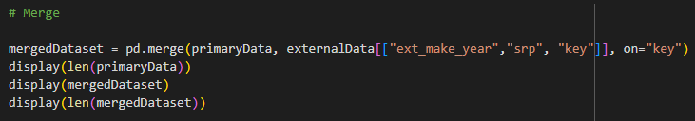
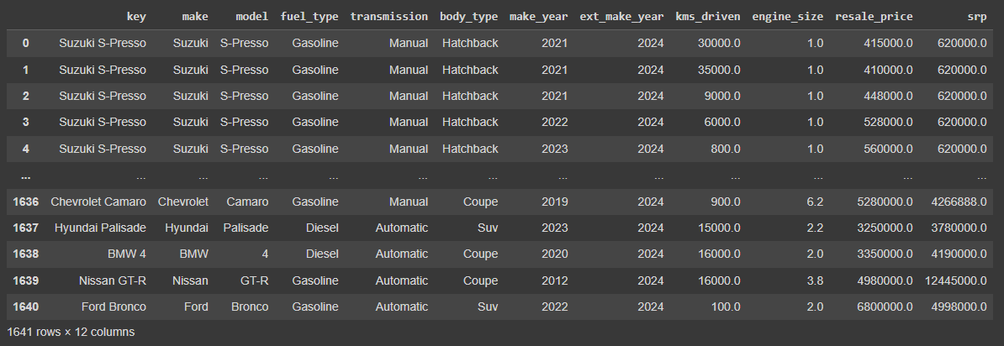
PART 3. MERGE
In this portion of the data processing, we merged transformedCleanedPrimaryData.csv, and transformedCleanedExternalData.csv by inner join, retaining all the columns from the primary dataset, and only getting the columns: “ext_make_year”, “srp”, and “key”.

Slide 49
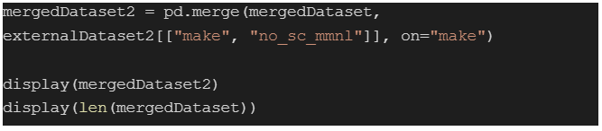
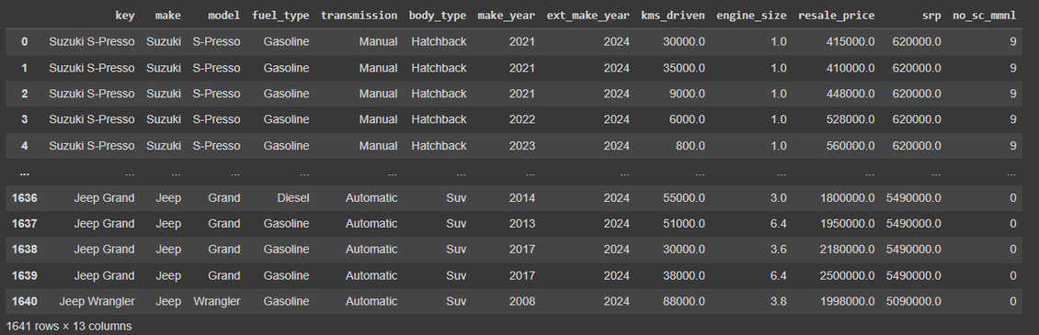
PART 3. MERGE
Now, with the second external dataset to merge it with, make_mshops.csv was imported into this part’s notebook and used inner join for two datasets: mergedDataset (the primary dataset, and the first external dataset), and make_mshops. We kept all the columns for the first merged dataset, and took the columns no_sc_mmnl (number of car service centers in Metro Manila), and make as the key for merging.

Slide 50
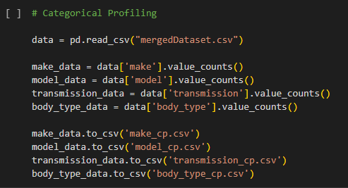
PART 4. CATEGORICAL PROFILING AND ENCODING CATEGORICAL VARIABLES
For Categorical Profiling, we got the frequency count of each values in the following variables:
make
model
transmission
body_type
We, then, saved the frequency data with respect to each of the variables

Slide 51
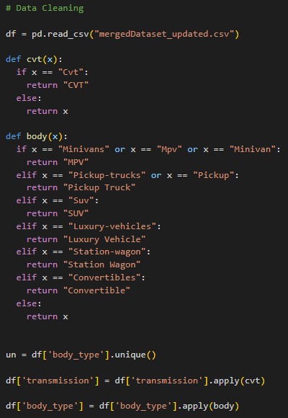
PART 4. CATEGORICAL PROFILING AND ENCODING CATEGORICAL VARIABLES
Before encoding the Categorical Variables, we had to do some data cleaning first in order to get more accurate data encoding.
According to the initial dataset, “Cvt” and “CVT” are two different transmission type (which are not). So we applied the function cvt() on the transmission column to ensure that all the values are unique.
Moreover, in the body_type column, we observed that “Pickup-trucks” and “Pickup” are treated as different values so we got to fix that. And upon further research, we found out that “Minivan” and “Mpv” are the same. Thus, along with the “Minivans” value, we re-wrote it under “MPV”.
Lastly, we refactored the other unique values to make it more “readable”.

Slide 52
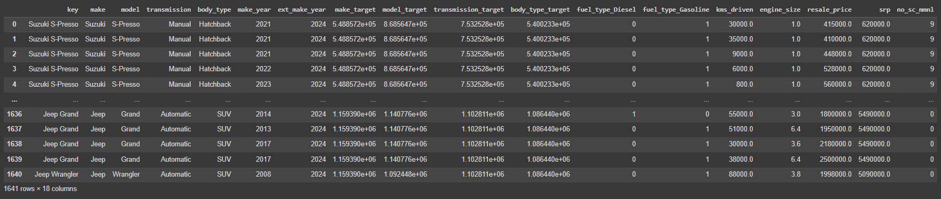
PART 4. CATEGORICAL PROFILING AND ENCODING CATEGORICAL VARIABLES
Now, for the fuel_type variable, we used one-hut encoding since there are only 3 unique values under it. Meanwhile, for the variables make, model, transmission, and body_type, we used both frequency encoding and target encoding. For the target encoding, we imported the category_encoders from sklearn and made use of TargetEncoder class. This makes the code fairly straight-forward and easy rather than encoding it from scratch.

Slide 53
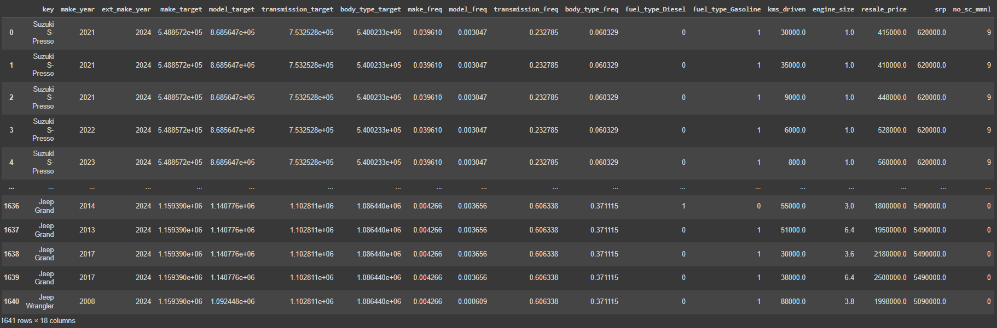
PART 4. CATEGORICAL PROFILING AND ENCODING CATEGORICAL VARIABLES
Now, for the frequency encoding, we just took the frequency count of each unique values and normalize it within its respective column/variable. We, then, mapped the values in their respective categorical values.

Slide 54
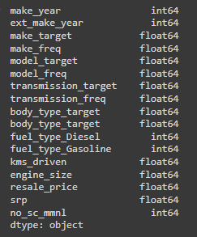
PART 4. CATEGORICAL PROFILING AND ENCODING CATEGORICAL VARIABLES
After dropping the key column (which are the brand and model of the cars), we now have a purely numerical dataset which can be used for modelling and data analysis.

Slide 55
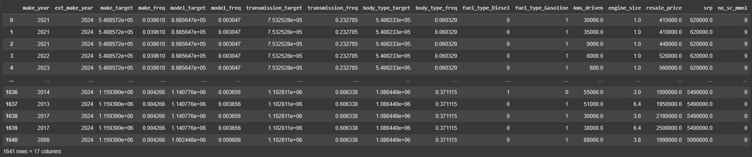
OUR FINAL DATASET

Slide 56
OUR FINAL DATASET
make_year
- the year in which a particular car is made (Independent Variable)
ext_make_year
- the year in which (brand new) cars from the external dataset are made (Independent Variable)
make_target
- target encoded values of brands that made a given car (Independent Variable)
make_freq
- frequency encoded values of the brands that made a given car (Independent Variable)
model_target
- target encoded values of the model of each car (Independent Variable)
model_freq
- frequency encoded values of the model of each car (Independent Variable)

Slide 57
OUR FINAL DATASET
transmission_target
- target encoded values of a certain car’s transmission (Independent Variable)
transmission_freq
- frequency encoded values of a certain car’s transmission (Independent Variable)
body_type_target
- target encoded values of a car’s body type (Independent Variable)
body_type_freq
- frequency encoded values of a car’s body type (Independent Variable)
fuel_type_Diesel
- one-hut encoded value that indicates whether a car’s fuel type is Diesel or not (Independent Variable)
fuel_type_Gasoline
- one-hut encoded value that indicates whether a car’s fuel type is Gasoline or not (Independent Variable)

Slide 58
OUR FINAL DATASET
kms_driven
- the total distance (in km) that a car has traveled prior its sale (Independent Variable)
engine_size
- the engine size of a particular car (Independent Variable)
resale_price
- a car’s resale price in the market (Dependent Variable)
srp
- a car’s suggested retail price in the market (Independent Variable)
no_sc_mmnl
- number of service centers in metro manila, that is, per manufacturer/make (Independent Variable)

Slide 59
VI. EXPLORATORY DATA ANALYSIS

Slide 60
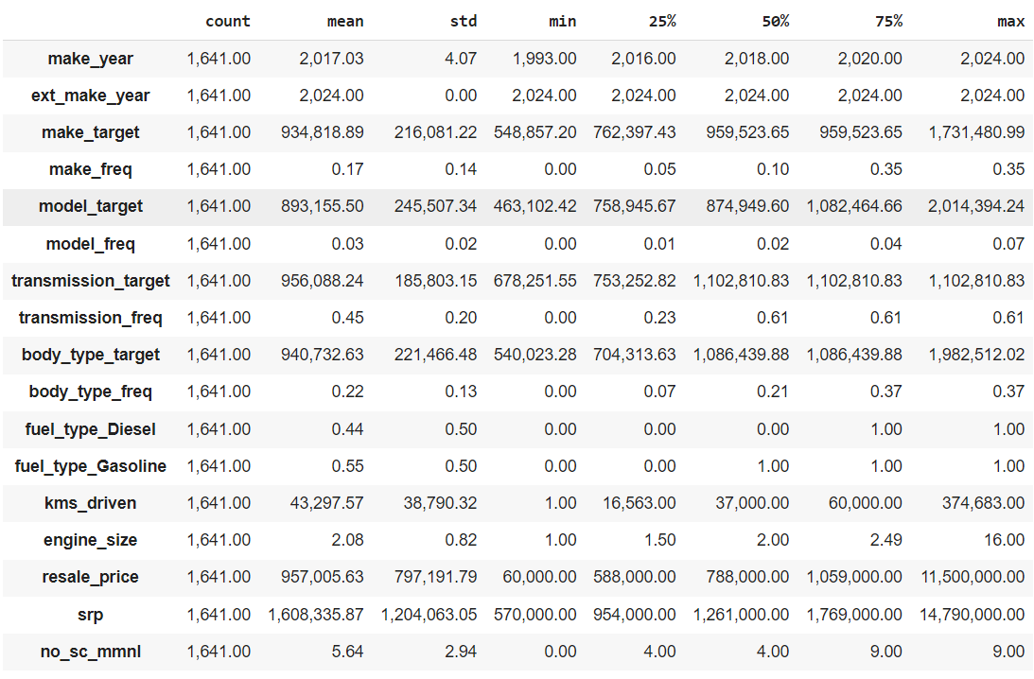
PART 1. STATISTICS SUMMARY
There are 1641 cars. Based on the statistics summary, years range from 1993-2024 for both used and brand new cars. 25% of the cars were created from 2020 onwards. 55% of cars are running on gasoline while 44% are running on diesel, and the remaining 1% are hybrid. Cars can be driven on an average of around 43000 km. Car prices range from 60K to 11.5 M. 25% of the cars can be brought to 9 service centers in Metro Manila, which is the maximum value of the said variable.

Slide 61
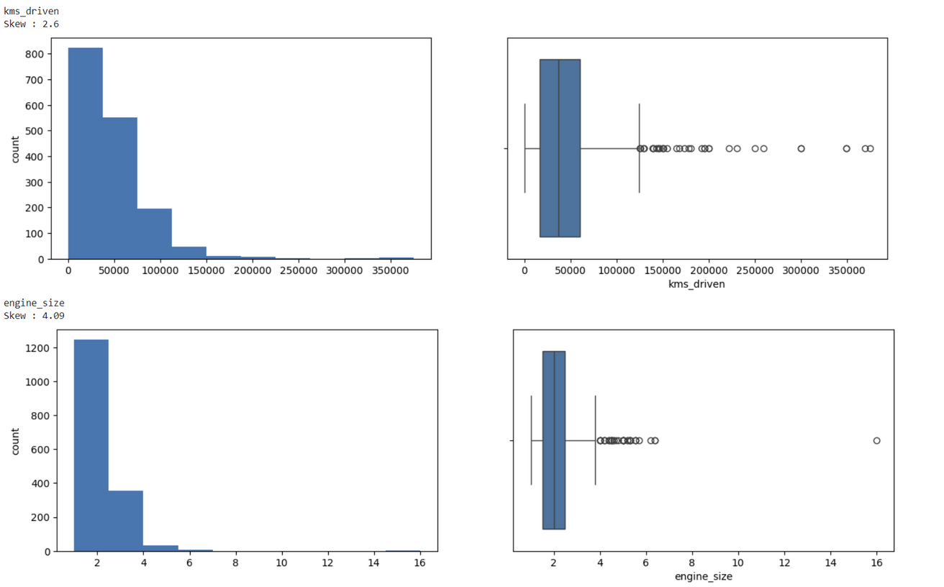
PART 2. UNIVARIATE ANALYSIS
Numerical variables are visualized into histograms and boxplots, and some of the variables are shown to have high skewness. There is no further visualization since there are no categorical variables in the dataset.

Slide 62
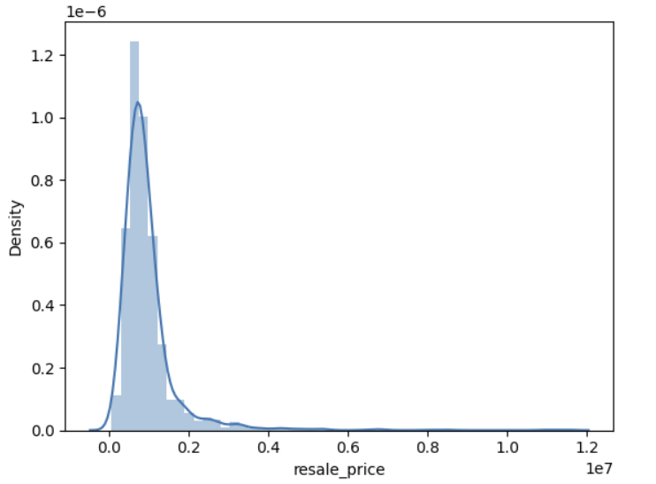
PART 2. UNIVARIATE ANALYSIS
Since the resale price is highly skewed, log transformation could be used in normalizing the variables.

Slide 63
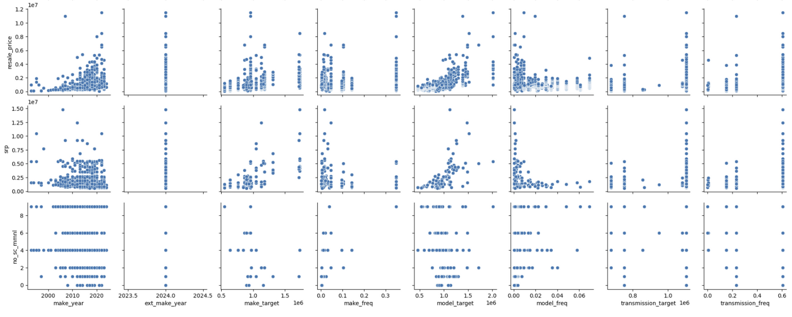
PART 3. BIVARIATE ANALYSIS
A pair plot was used to visualize the relationship between two variables from the dataset.
Note: The visualization above is NOT the full pair plot due to the limited space of a slide. Kindly see the full pair plot in the EDA Python notebook in the Google drive.

Slide 64
PART 3. BIVARIATE ANALYSIS
Some observations from the pair plot:
The resale price has a positive correlation of make year, model target, engine size, and SRP. That shows that a car's price is higher if a specific car is made recently.
Kilometers-driven has a negative correlation with price.
SRP is positively correlated with model target and engine size.
As make frequency increases, the model frequency increases.

Slide 65
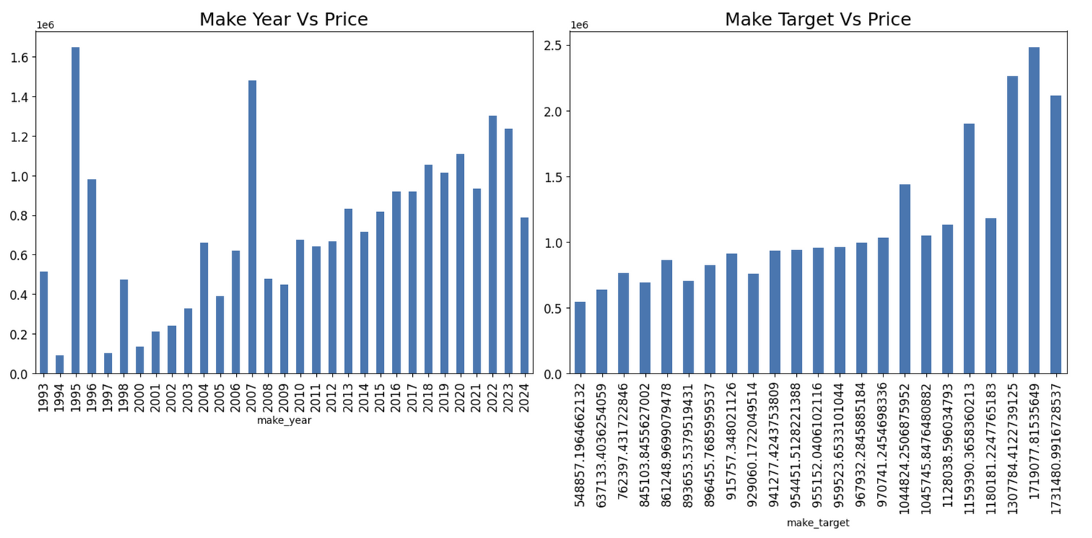
PART 3. BIVARIATE ANALYSIS
Bar plots were also used to visualize the relationship between two numerical variables and the resale price since it is a continuous variable. Numerical variables include make year, make (both target and frequency), model frequency, transmission (both target and frequency), body type, and no. of service centers in Metro Manila.
Note: The visualization above is two of the eight bar plots made for EDA.

Slide 66
PART 3. BIVARIATE ANALYSIS
Some observations from the bar plots:
Manufactured cars in 1995 have the highest resale price even though cars made in 1994 and 1997 are sold in the lowest price.
As the make target increases, the price increases.
Cars with a transmission from around 800k-900k are low in price.
A car with a high body type is high in price.
Cars that can be brought to 0-2 service centers in Metro Manila are usually high in price.

Slide 67
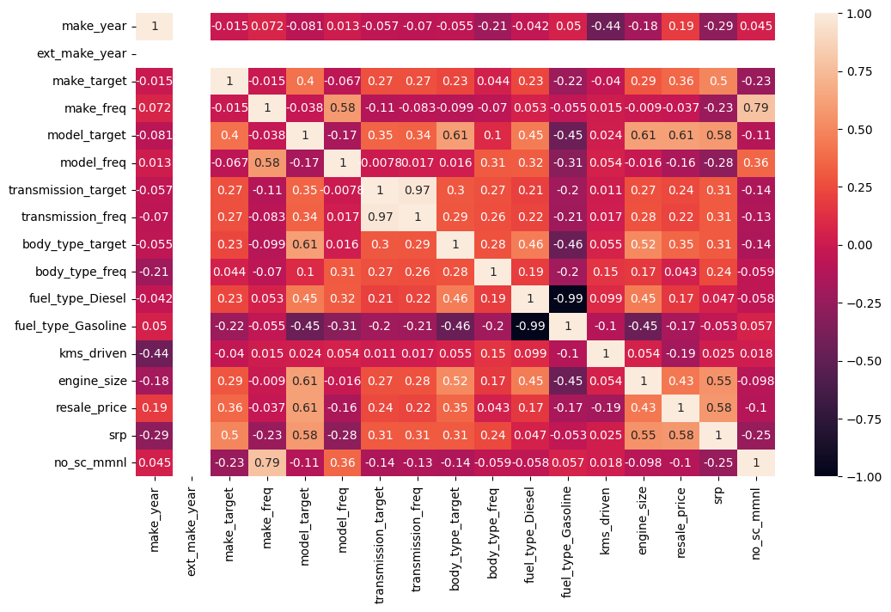
PART 4. MULTIVARIATE ANALYSIS
A heat map was used to show the correlation between two variables from the dataset.

Slide 68
PART 4. MULTIVARIATE ANALYSIS
Make year and kilometers-Driven are very weakly correlated to most of the variables from the dataset. Resale price has a positive correlation to diesel cars and a negative correlation to gasoline cars. Model frequency does not create much impact on body type, engine size, and transmission (both target and frequency encoding). However, model target has a fairly strong positive correlation to body type, engine size, and the price. One fuel type has a very strong negative correlation to one other fuel type (-0.99). Make frequency has a strong positive correlation to the number of service centers in Metro Manila. SRP is fairly strongly positive in correlation to make target, model target, engine size, and price.

Slide 69
REFERENCES
AutoDeal. (n.d.). AutoDeal. https://www.autodeal.com.ph/
ZigWheels. (n.d.). ZigWheels. https://www.zigwheels.ph/
Collard, M. (2022). Price Prediction for Used Cars: A Comparison of Machine Learning Regression Models. Mittuniversitetet. Retirieved from: https://www.diva-portal.org/smash/get/diva2:1674070/FULLTEXT01.pdf
Totakura, S. S. G., Kosuru, H. (2021). Comparison of Supervised Learning Models for predicting prices of Used Cars. Blekinge Institute of Technology. Retrieved from: https://www.diva-portal.org/smash/get/diva2:1609361/FULLTEXT02?fbclid=IwZXh0bgNhZW0CMTEAAR3yUWYBnT5AnLIPvY_zewsNCA17EvXv_zdrV41S9eiIkBA82FJNDuwphkY_aem_FHnXVVSOhM7AcY6tBvV_wQ

